Slide 1
Integrative Data Analysis with Multi-Source Data
Daniel J. Bauer¹ Andrea L. Howard²
Patrick J. Curran¹ Andrea M. Hussong¹
¹Center for Developmental Science and Dept. of Psychology and Neuroscience, University of North Carolina at Chapel Hill
²Department of Psychology, Carleton University

Slide 2
Integrative Data Analysis
The analysis of raw data pooled across multiple, often independently conducted studies

Slide 3
Advantages
Increases power through data aggregation
Permits formal tests of the reproducibility of findings across studies
Provides a way to combine longitudinal research conducted over different age intervals to cover a wider developmental span

Slide 4
The Challenge of Measurement
Among the many challenges for IDA is measurement
Are the same constructs measured in each contributing study?
Are they measured using the same or similar items across studies?

Slide 5
Ideal Scenario
Measure A
Study 1:
Common Items
Study 2:
Study 3:

Slide 6
More Difficult Scenario
Measure A
Study 1:
Harmonized Common Item
Measure B
Study 2:
Measure C
Study 3:

Slide 7
Psychometric Modeling
Posit factor analysis / item response theory model for pooled item set
Score factor in each study
Under measurement invariance factor scores have same meaning and metric, despite differences in observed item sets

Slide 8
Factor Analysis
F
Same Factor
Pooled:
Study 1:
Study 2:
Different Items
Study 3:

Slide 9
Testing Measurement Invariance
Important to evaluate comparability of scores by testing whether common item parameters are equal across studies
Testing DIF especially important for harmonized items
But DIF may also exist for identical items (e.g., context effects)
Often need to simultaneously consider DIF due to other covariates
Gender, age, etc.
Especially those that covary with study

Slide 10
Multi-Source Data
To date, use of psychometric models to facilitate IDA has focused on single-source data
Example: Self-reported negative affect
However, longitudinal research often involves multi-source data
Best practice to use multi-method approach
Optimal informant may change with development
May differ across studies

Slide 11
Sources of Information
Partner
Study 3
Peer
Study 4
Self
Teacher
Study 2
Study 1
Parent
Age

Slide 12
Psychometric Models for Multi-Source Data
Tri-Factor Model (TFM) provides one way to model multi-source data
Can be adapted to generate common measures for integrative data analysis

Slide 13
Example TFM Application
Bauer et al. (2013) fit the TFM to data drawn from two longitudinal studies of children of alcoholics
Michigan Longitudinal Study (MLS; PI: Zucker), age 2-18
Adolescent and Family Development Project (AFDP; PI: Chassin), age 10-18
Negative Affect rated by mothers and fathers
13 identical items in both studies rated by both reporters
Key covariates:
Study, Age, Gender, and Parental Alcoholism, ASP, and Depression

Slide 14
Data Structure
Mother
Father
MLS:
1
2
3
4
5
…
13
1
2
3
4
5
…
13
Common Items
AFDP:
1
2
3
4
5
…
13
1
2
3
4
5
…
13

Slide 15
TFM
Age, Sex, Gender
Impairment_{M}
Impairment_{F}
NA
P_{M}
P_{F}
Mother
1
2
3
4
5
…
13
1
2
3
4
5
…
13
Father
S₁
S₂
S₃
S₄
S₅
…
S₁₃

Slide 16
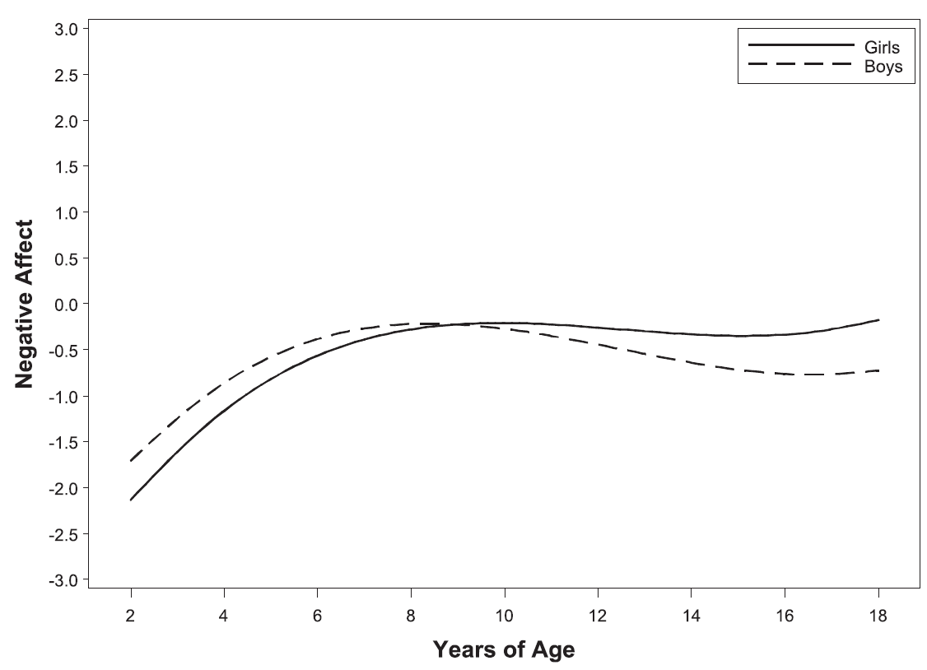
General Results
Age and gender trends in NA
Higher NA with parent ASP
Higher NA with parent dep
Higher P_{M} / P_{F} with parent dep

Slide 17
Important Question
In this application same reporters were available in each study, ensuring all scores based on the same information
But are scores comparable even if some sources of information are missing for some studies?
Unclear, given complex factor structure
Here we provide a preliminary empirical assessment

Slide 18
Preliminary Assessment
Used the TFM estimates from the NA application to score the data three ways
Complete data on both reporters
Data missing on moms
Data missing on dads
IDA analogue with three “studies” differing in reporter sets

Slide 19
Data Configurations for Scoring
Mother
Father
No Dad
1
2
3
4
5
…
13
Complete
1
2
3
4
5
…
13
1
2
3
4
5
…
13
Same Data Records
No Mom
1
2
3
4
5
…
13

Slide 20
Complete
No Dad
No Mom
Age, Sex, Gender
Impairment_{M}
Impairment_{F}
NA
P_{M}
P_{F}
1
1
2
2
3
3
4
4
5
5
13
13
1
1
2
2
3
3
4
4
5
5
13
…
…
13
…
…
S₁
S₂
S₃
S₄
S₅
…
S₁₃

Slide 21
Score Correlations
Scores reproduced with accuracy even when sources vary
 | NA Complete | NA No Dad | NA No Mom
NA Complete | 1.00
NA No Dad | 0.90 | 1.00
NA No Mom | 0.88 | 0.65 | 1.00

Slide 22
Conclusions
Psychometric models offer opportunities to create commensurate measures from instruments that differ superficially across studies
One important potential difference in longitudinal studies is the source of information on targets
The tri-factor model offers one possible way to accommodate multi-source data when conducting IDA
Initial results suggest TFM may produce reasonably commensurate scores even when sources of information vary
But more research needed

Slide 23
Acknowledgments
The project described was supported by supported by National Institutes of Health grants R01 DA034636 (PI: Daniel Bauer) and R01 DA015398 (PIs: Andrea Hussong & Patrick Curran). The content is solely the responsibility of the authors and does not represent the official views of the National Institute on Drug Abuse or the National Institutes of Health.

Slide 24
References
Bauer, D.J., Howard, A.L., Baldasaro, R.E., Curran, P.J., Hussong, A.M., Chassin, L., & Zucker, R.A. (2013). A trifactor model for integrating ratings across multiple informants. Psychological Methods, 18, 475-493. doi: 10.1037/a0032475. PMCID: PMC3964937
Bauer, D.J. & Hussong, A.M (2009). Psychometric approaches for developing commensurate measures across independent studies: traditional and new models. Psychological Methods, 14, 101-125. doi:10.1037/a0015583 PMCID:PMC2780030
Curran, P.J., McGinley, J.S., Bauer, D.J., Hussong, A.M., Burns, A., Chassin, L., Sher, K., & Zucker, R. (2014). A moderated nonlinear factor model for the development of commensurate measures in integrative data analysis. Multivariate Behavioral Research, 49, 214-231, doi: 10.1080/00273171.2014.889594.
Hussong, A.M., Curran, P.J. & Bauer, D.J. (2013). Integrative data analysis in clinical psychology research. Annual Review of Clinical Psychology, 9, 61-89. doi:10.1146/annurev-clinpsy-050212-185522

Slide 25
Potential Source Variation Across Studies
Parent
Self
Study 1:
(Early)
Study 2:
(Mid)
Study 3:
(Late)

Slide 26
Potential Source Variation Across Studies
Parent
Self
Study 1:
(Early)
Harmonized Common Item
Study 2:
(Mid)
Study 3:
(Late)

