Slide 1
Constructing Common Measures for Integrative Data Analysis:
Score Performance
Daniel J. Bauer, Veronica T. Cole,
Nisha C. Gottfredson, Patrick J. Curran
Andrea M. Hussong

Slide 2
Performance of predicted scores
This presentation will pick up where Patrick’s left off…
Core question: How will predicted latent variable scores perform in integrative data analysis?
  Latent variable scores provide common measures for IDA that take into account variation in item sets and item functioning
  But scores imperfect, so important to know how they will perform in analyses

Slide 3
Why use scores at all?
Not always desirable or tractable to fit measurement model and hypothesized model simultaneously
  Address separate substantive issues
  Can be computationally burdensome
    Many repeated measures
    Complex nonlinear measurement models required for multiple constructs
  Potential for propagation of misspecification bias

Slide 4
What is already known
Suppose this model holds in the population:
But fit in steps:
  Fit factor model to y (ignoring z)
  Generate based on y and step 1 parameter estimates
  Regress z on
y₁
y₁
y₁
y₂
y₂
y₂
η_{J}
η
η
η_{J}
z
z
ε
ε
. . .
. . .
. . .
y_{J}
y_{J}
y_{J}

Slide 5
What is already known
Performance depends on scoring method
  EAP, MAP, ML, etc.
  EAP is most optimal for scenario considered here
When using EAPs in regression models:
  Regression coefficients are consistent
  Residual variance too large, R² too small

Slide 6
What is already known
If z will be predicted by other variables these must also be present in the scoring model
Full Model
Step 1
Step 2
Step 3
x₁
x₁
x₁
x₁
x₂
x₂
x₂
y₁
x₂
y₁
y₁
y₂
y₂
y₂
η_{J}
η_{J}
η
η
z
z
ε
ε
. . .
. . .
. . .
y_{J}
y_{J}
y_{J}

Slide 7
What isn’t known
Finite sample performance of predicted factor scores
  At what N does consistency begin to kick in?
Importance of impact
  Bias reduction, but offset by excessive sampling variability due to model complexity?
Consequences of DIF
  Removal of items with DIF infeasible for IDA
  How much does modeling DIF matter?
Performance of scores generated from MNLFA
  Provides for flexible modeling of impact and DIF for IDA

Slide 8
Current study
Generated data from MNLFA including impact and DIF
  Same conditions Patrick described in his talk
  Conditioning variables are Age, Study, Gender
Produced predicted scores via
  Binary CFA (P0)
  MNLFA with impact (PI)
  MNLFA with impact and DIF (PID)
Regression model of interest is:
Misspecified
Correctly specified

Slide 9
General Pattern of Results
When scores fail to account for impact and/or DIF, bias for some β 's but not others
  Meaningful bias even under “small” DIF
  More items helps a little
When scores account for both impact and DIF no bias for β 's and comparable or smaller RMSE
  Even at N = 500
σ ² always positively biased
  More items helps a lot
  Accounting for impact and DIF in scoring model helps a little
Larger N reduces sampling variability but not bias

Slide 10
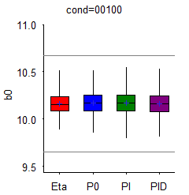
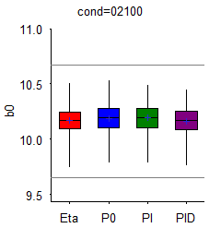
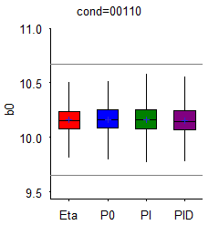
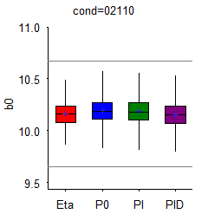
Intercept, N = 500
6 items
24 items
Small DIF
Nothing to see here
Large DIF

Slide 11
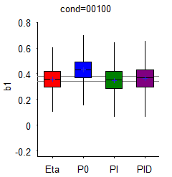
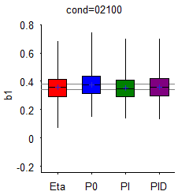
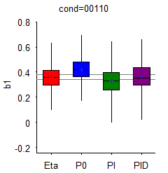
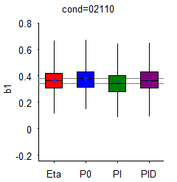
Age Main Effect, N = 500
6 items
24 items
Small DIF
For this effect, including impact most critical
Large DIF

Slide 12
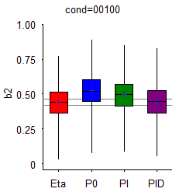
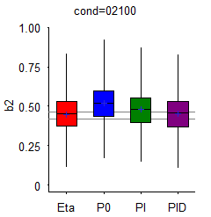
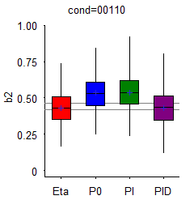
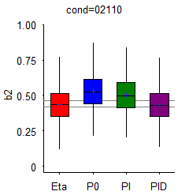
Gender Main Effect, N = 500
6 items
24 items
Small DIF
Biased unless scoring accounts for both impact and DIF
Large DIF

Slide 13
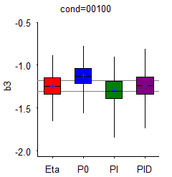
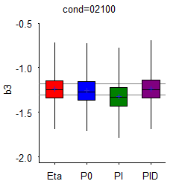
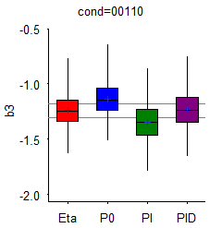
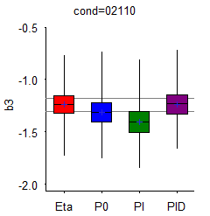
Study Main Effect, N = 500
6 items
24 items
Small DIF
Biased unless scoring accounts for both impact and DIF
Large DIF

Slide 14
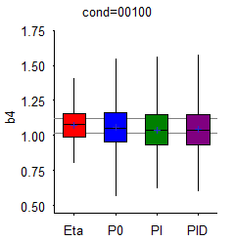
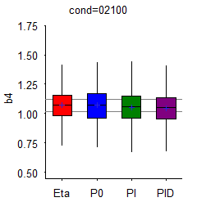
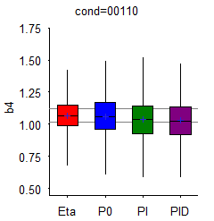
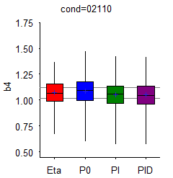
η Main Effect, N = 500
6 items
24 items
Small DIF
Oddly, little bias regardless of scoring model
Large DIF

Slide 15
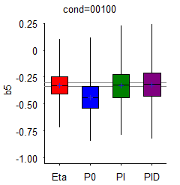
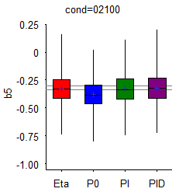
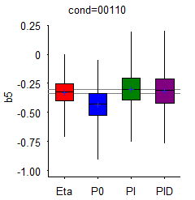
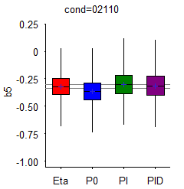
η x Study Interaction, N = 500
6 items
24 items
Small DIF
For this effect, including impact most critical
Large DIF

Slide 16
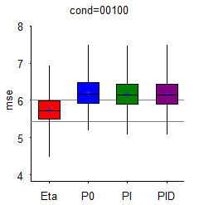
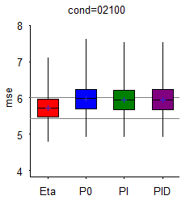

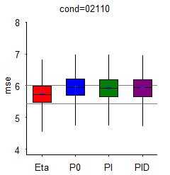
σ ², N = 500
6 items
24 items
Small DIF
Always positively biased, but improves with more items
Large DIF

Slide 17
Conclusions
The complexity of the MNLFA can be of practical value
  Accounting for impact and DIF reduces bias with little increase in sampling variability
Use of MNLFA to produce common measures for IDA appears well-justified by these results
  Which is good, since we’ve already done it several times
But still much to learn
  Relative importance of conditioning mean versus variance
  Consequences of over fitting
  Inference: SE bias, CI coverage, Type I and Type II errors

Slide 18
Acknowledgements and Disclaimer
The project described was supported by supported by National Institutes of Health grant R01 DA034636 (PI: Daniel Bauer; co-Is: Patrick Curran, Andrea Hussong). The content is solely the responsibility of the author and does not represent the official views of the National Institute on Drug Abuse or the National Institutes of Health.
FAKE-U Collaborators
James McGinley
Andrew Rothenberg
Andrew Schaper

