Slide 1
How Mixture Models Can and Cannot Further Developmental Science
Daniel J. Bauer

Slide 2
Overview
What are mixture models?
  Focus on mixture models with latent variables, or Structural Equation Mixture Models (SEMMs)
Problems associated with direct applications of SEMMs
  Identifying qualitatively distinct “hidden” population subgroups
Opportunities associated with indirect applications of SEMMs
  Approximating features of data that might be difficult to recover with a standard SEM

Slide 3
What are SEMMs?
Not just another pretty acronym

Slide 4
Finite Mixture Models
Finite mixture models assume that the distribution of a set of observed variables can be described as a mixture of K component distributions (aka “classes”)
y

Slide 5
Types of Mixture Applications
Direct Applications
Indirect Applications
“By a direct application, we have in mind a situation where we believe, more or less, in the existence of K underlying categories or sources…”
“By an indirect application, we have in mind a situation where the finite mixture form is simply being used as a mathematical device in order to provide an indirect means of obtaining a flexible, tractable form of analysis.”
Titterington, Smith & Makov (1985, pp. 2-3)

Slide 6
Structural Equation Mixture Models
SEMMs are finite mixture models in which the moments of the component distributions are implied by a set of structural equations
For a given component k, stipulate equations
Implied moments are
SEMM is then
Jedidi, Jagpal & DeSarbo (1997)

Slide 7
Additional Features of SEMMs
Can include exogenous predictors in two ways
  by using conditional component distributions (within-class)
  predicting mixing probabilities (between-class)
Can include endogenous variables of mixed scale types (e.g., binary, ordinal, continuous, count)
  must assume conditional independence for some scale types so can factor g_{k}
Arminger, Stein & Wittenberg (1999); Muthén & Shedden (1999)

Slide 8
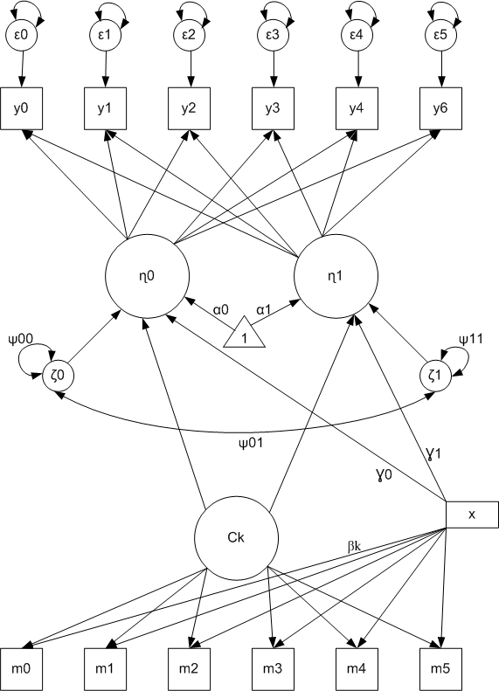
Example SEMM: Growth Mixture Model

Slide 9
SEMM as an Integrative Model
Traditional latent variable models assume one type of latent variable
  Latent class / profile analysis assumes discrete latent variables
  IRT, Factor analysis, SEM assume continuous latent variables
SEMM includes both continuous and discrete latent variables
  Continuous latent factors as in factor analysis and SEM
  Discrete latent variable (component membership) as in latent class/profile analysis
Integration introduces new complexities

Slide 10
Direct Applications of SEMMs
Data mining for fool’s gold

Slide 11
Direct Applications
Most applications of SEMM to date have been direct applications
The goal is thus to identify “hidden” population subgroups
Here we are concerned with fitting
multivariate normal finite mixtures in direct applications
subject to structural equation modeling. . .
Dolan & van der Maas (1998)

Slide 12
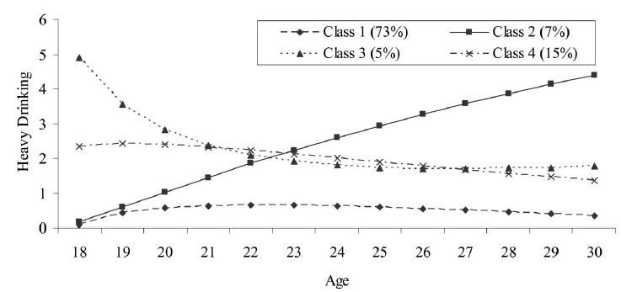
Example
Growth mixture models are commonly applied to identify subgroups characterized by distinct trajectories
Muthén & Muthén (2000)

Slide 13
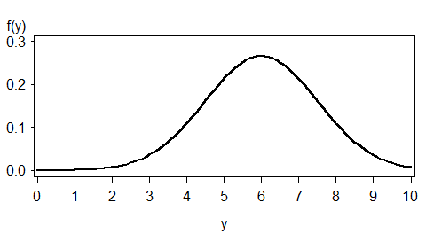
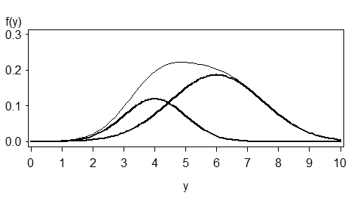
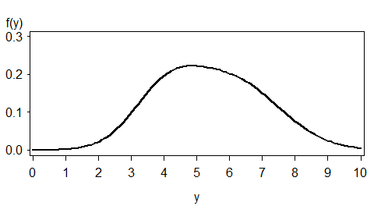
Example
SEMMs can also used to evaluate whether treatment is differentially beneficial across subgroups
Control
2 Classes:
Responders
Non-Responders
Treatment
Hancock (2011)

Slide 14
Problems with Direct Applications
In direct applications the latent classes are interpreted to correspond to literal groups in the population
Unfortunately, there are many other reasons one might obtain evidence of multiple latent classes in an SEMM analysis
  Non-normality
  Nonlinearity
  Model Misspecification

Slide 15
The Problem of Non-Normality
Pearson (1895, p. 394):
2 Groups or Just an Approximation?
2 Groups or Just an Approximation?
2 Groups or Just an Approximation?
.30
.30
“The question may be raised, how are we to discriminate between a true curve of skew type and a compound curve [or mixture].”
.30
.20
.20
.20
f(x)
f(x)
Frequency
f(x)
Frequency
Frequency
Frequency
.10
.10
.10
0
0
0
x
x
x
x

Slide 16
The Problem of Non-Normality
3000
Normal
2000
Consider data generated from a latent curve model with varying degrees of non-normality
  No latent classes in population model
At N=600, 2 classes are selected 100% of the time when data were non-normal
  Latent classes needed to approximate non-normal distributions
1000
0
Skew 1, Kurtosis 1
2000
Frequency
1000
0
Skew 1.5,
Kurtosis 6
2000
1000
Bauer & Curran (2003)
0
-5.0
-4.0
-3.0
-2.0
-1.0
0.0
1.0
2.0
3.0
4.0
5.0
6.0
7.0
y

Slide 17
The Problem of Non-Normality
Mixtures of normals are necessarily non-normal (unless degenerate)
But non-normal distributions need not arise from mixtures of normals
In most GMM applications, limitations of measurement alone would produce non-normality, irrespective of population heterogeneity
  Outcomes were proportions, ordinal variables, log-transformed counts, or linear composites of Likert items with evident floor/ceiling effects
Bauer & Curran (2003); Bauer (2007)

Slide 18
The Problem of Nonlinearity
Another potential source of spurious latent classes is non-linear relationships
Suppose population model includes a quadratic effect:
.33
.33
.33
.33
.33
.33
y₁
y₂
y₃
y₄
y₅
y₆
1*
1
1
1*
1
1
η₁
η₂
α₁ = 0
ψ₁₁ = 1
α₂ = .5
ψ₂₂ = .25
-.5η₁+.5η₁²
Bauer & Curran (2004)

Slide 19
The Problem of
Nonlinearity
Fitting linear SEMM produces spurious evidence of classes
At N=500, 2 or more classes were selected by BIC in 100% of replications
50%
η₂
50%
η₁
Bauer & Curran (2004)

Slide 20
The Problem of Misspecification
Yet another potential source of spurious classes is model misspecification
Marginal covariance matrix is an additive function of between-class mean differences and within-class covariance:
When within-class associations are misspecified, estimation of more classes will improve model fit
Bauer & Curran (2004)

Slide 21
The Problem of Misspecification
1-Class GMM with Random Effects
(Correct)
4-Class GMM without
Random Effects
(Misspecified)
6%
41%
y
42%
11%
0
Time
Time
Bauer & Curran (2004)

Slide 22
Problems for Direct Applications
The problem with direct applications of SEMMs is that latent classes may serve many different roles in the model
  Capture population subgroups
  OR
  Capture non-normality
  Capture nonlinearity
  Compensate for misspecification, dependencies otherwise unmodeled
What are problems for direct applications are, however, opportunities for indirect applications

Slide 23
Indirect Applications of SEMMs
Off the beaten path analysis

Slide 24
Indirect Applications
Currently few indirect applications of SEMM
Not the initial motivation for SEMM, but might indirect applications be more fruitful than direct applications?
In indirect applications the finite mixture
model is employed as a mathematical device...
In such applications, the underlying components
do not necessarily have a physical interpretation.
Dolan & van der Maas (1998)

Slide 25
Non-Normality: Problem or Opportunity?
Problem: Latent classes may be estimated solely in the service of capturing non-normal data
Opportunity: Latent variable density estimation
  Avoid the assumption of normality
  Estimate the distribution of the latent trait

Slide 26
Latent Density Estimation
Simulated Data:
  Two factor linear CFA, N = 400
  Distributions of Latent Factors: Skew = 2, Kurtosis = 8
f (ξ₁)
f(η₁)
79%
21%
η₁
η₁
ξ₁
Bauer & Curran (2004)

Slide 27
Latent Density Estimation
Recent interest in latent density estimation in item response theory
  Desire not to inappropriately assume normal distribution for trait
  Interest in features of distribution
Ramsay-Curve IRT models are one option. Mixture factor analysis models are another.
  Virtually no difference in integrated squared error for unidimensional models with binary or ordinal items
  Unlike RC-IRT, however, straight-forward to extend mixture analysis to multidimensional models
Woods, Bauer and Wu (in progress)

Slide 28
Nonlinearity: Problem or Opportunity?
Problem: Latent classes may be estimated solely in the service of capturing non-linear relationships between latent variables
Opportunity: Semiparametric estimation of latent variable regression functions
  Are the latent variables nonlinearly related?
  Are there latent variable interactions?

Slide 29


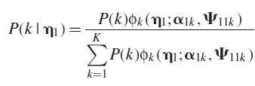
Nonlinear Effect Estimation by SEMM
Locally linear within component:
Global function is nonlinear:
Smoothing weights are conditional probabilities:
Bauer (2005)

Slide 30
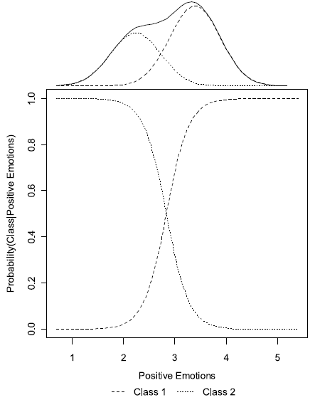
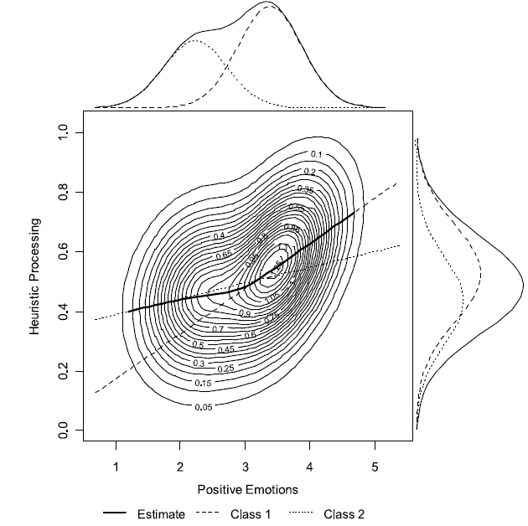
Example
Pek, Steba, Kok & Bauer (2009)

Slide 31
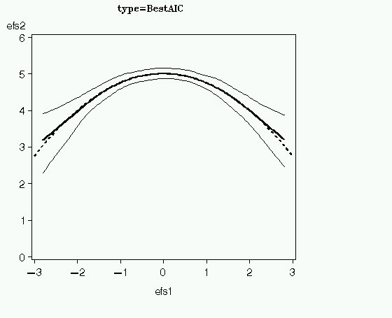
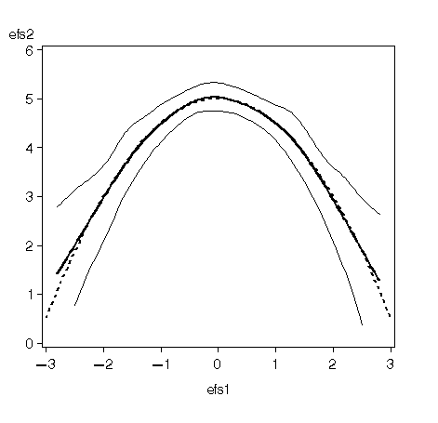
Function Recovery
Moderate Quadratic
Large Quadratic
Bauer, Baldasaro & Gottfredson (in press)

Slide 32
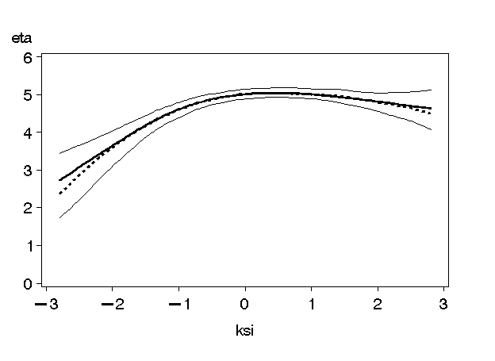
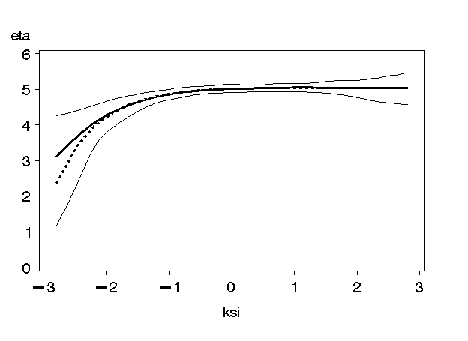
Function Recovery
Quadratic Spline
Exponential
Bauer, Baldasaro & Gottfredson (in press)

Slide 33
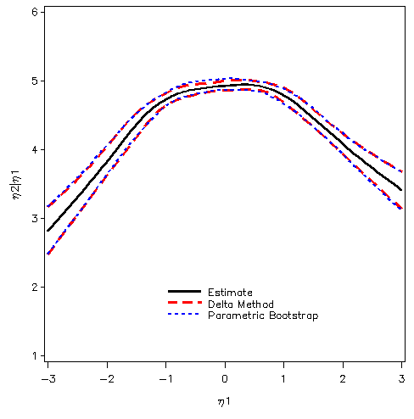
One Replication: Quadratic
Pek, Losardo & Bauer (2011)

Slide 34
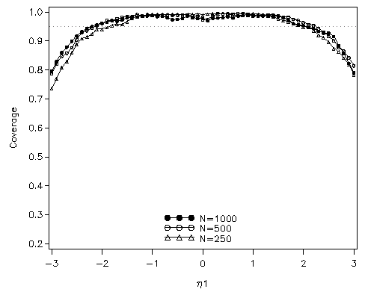
CI Coverage Rates
Pek, Losardo & Bauer (2011)

Slide 35
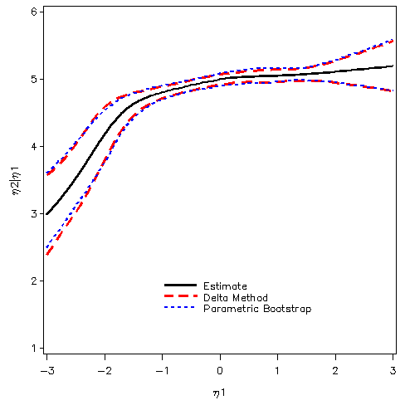
One Replication: Exponential
Pek, Losardo & Bauer (2011)

Slide 36
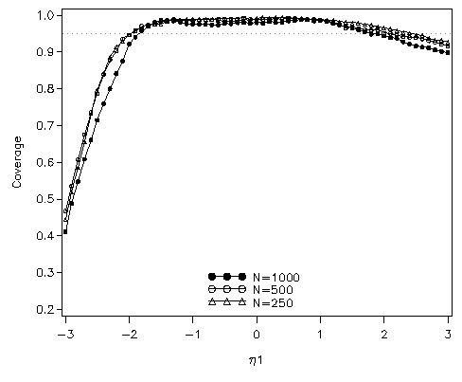
CI Coverage Rates
Pek, Losardo & Bauer (2011)

Slide 37
Extending to Nonlinear Surfaces
Class 1
Aggregate Surface
Class 2
Mathiowetz (2010); Baldasaro & Bauer (in press)

Slide 38
Example SEMM plots
Quadratic
2-Class
True
Mathiowetz (2010); Baldasaro & Bauer (in press)

Slide 39
Example SEMM plots
Bilinear interaction
2-Class
True
Mathiowetz (2010); Baldasaro & Bauer (in press)

Slide 40
Dependence: Problem or Opportunity?
Problem: Latent classes may be estimated to account for dependencies in the data not captured by the within-class model.
Opportunity: Use latent classes to capture dependencies not adequately captured in conventional ways
  Modeling longitudinal data with non-random missingness
  Multiple process survival analysis

Slide 41
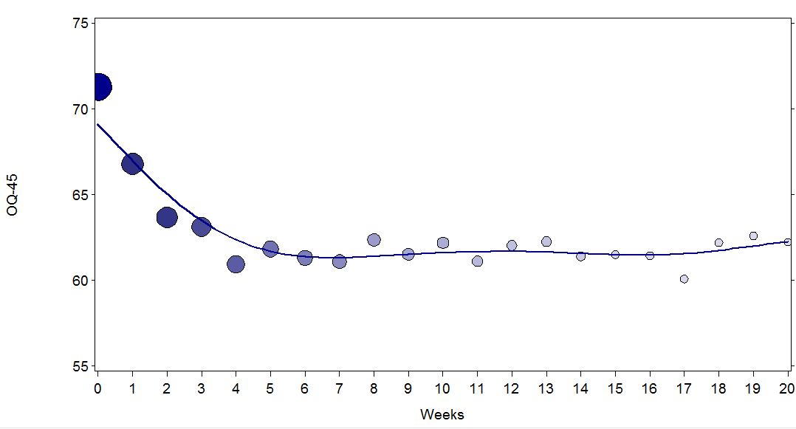
Non-Random Missing Data
A Random Coefficient Dependent Missing Data Process
Gottfredson (2011)

Slide 42
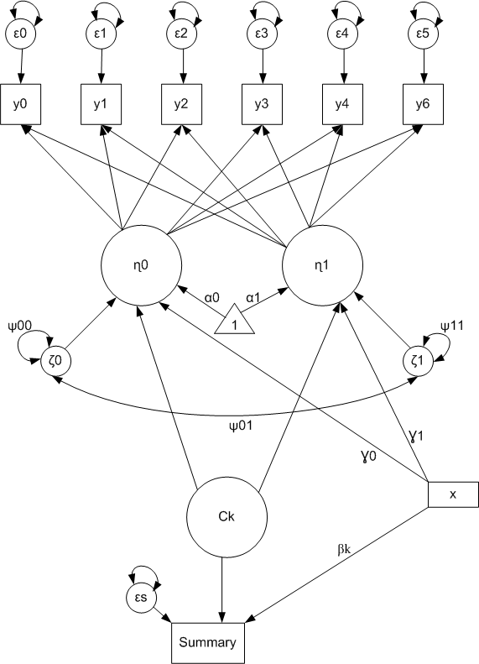
Missing Data
Shared Parameter Mixture Model
Latent classes are shared parameters between growth and missing data processes
  Growth factor means vary across classes with missing data patterns
  Captures RC-Dependent MNAR process
Gottfredson (2011)

Slide 43
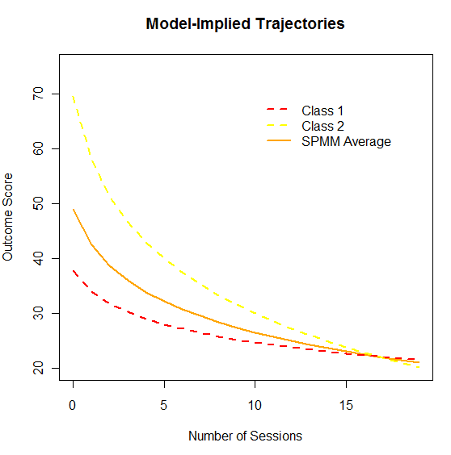
Shared Parameter Mixture Model
Determine number of classes necessary to ensure within-class independence of y and m
Aggregate across classes to obtain the marginal trajectory
Average is a weighted combination of Class 1 and Class 2
Gottfredson (2011)

Slide 44
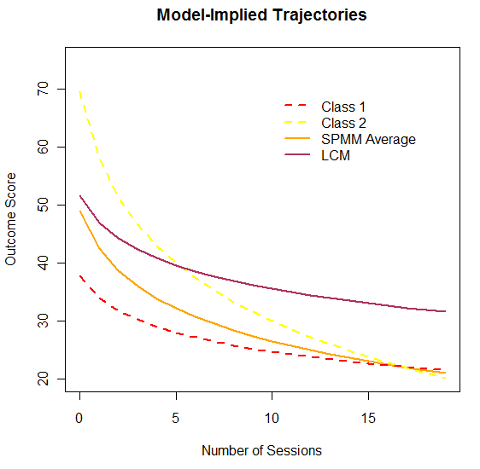
Shared Parameter Mixture Model
Moderately
large
difference
Gottfredson (2011)

Slide 45
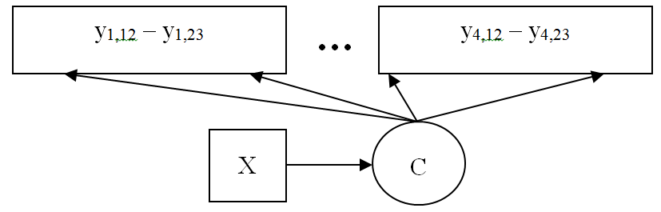
Multiple Process Survival Analysis
Survival analysis usually conducted one outcome at a time
  Whether and when an event occurs (e.g., onset of substance use)
Can re-formulate discrete time multiple process hazard model as a latent class analysis
  Latent classes provide a semi-parametric approximation to the multivariate distribution of event times
Dean (in progress)

Slide 46
Multiple Process Survival Analysis
Example: What is distribution of event occurrence for use of legal and illegal substances?
2009 National Survey of Drug Use and Health (NSDUH)
  N=55,772
  Concerned with age of onset of
    Alcohol
    Tobacco
    Marijuana
    Other Drug Use
Dean (in progress)

Slide 47
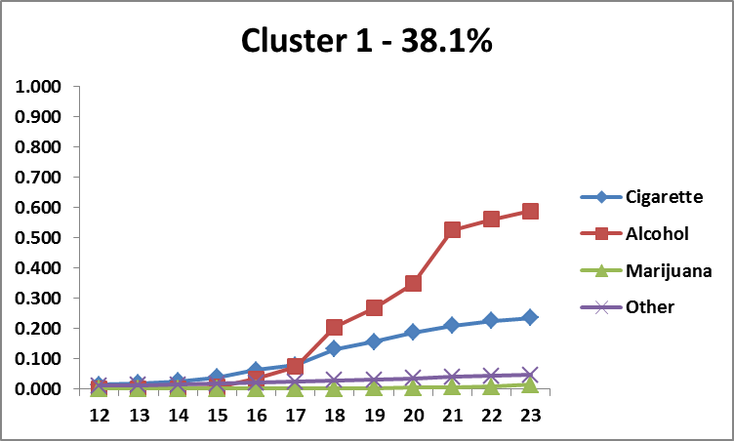
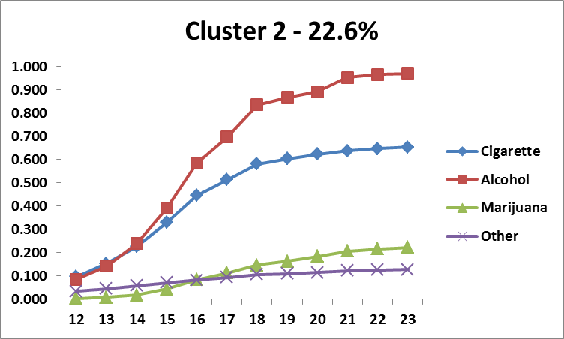
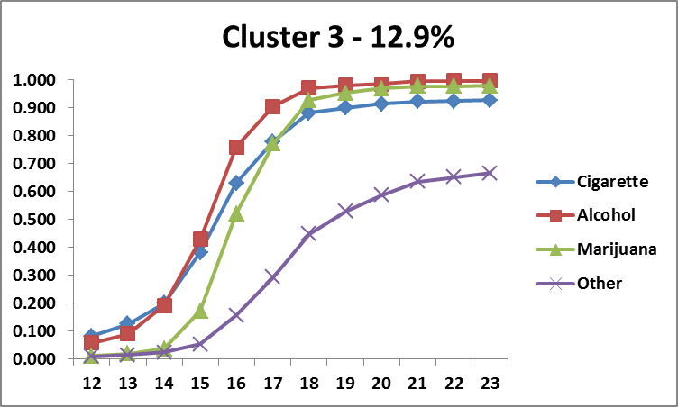
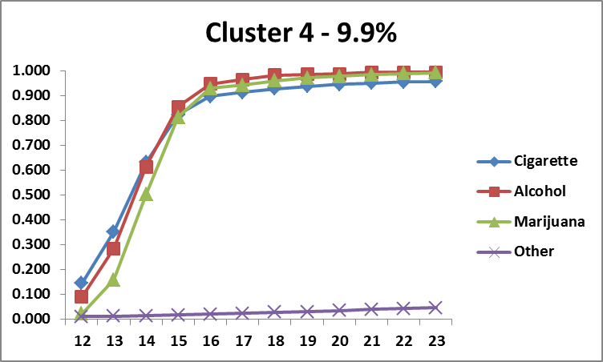
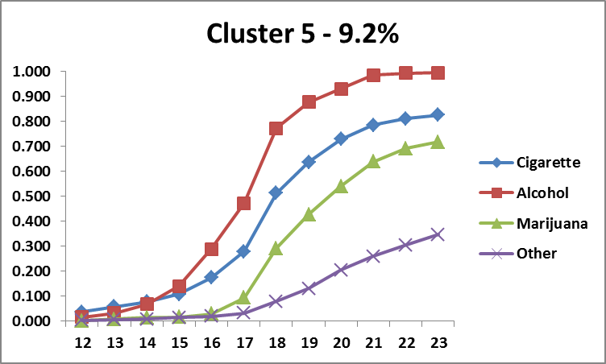
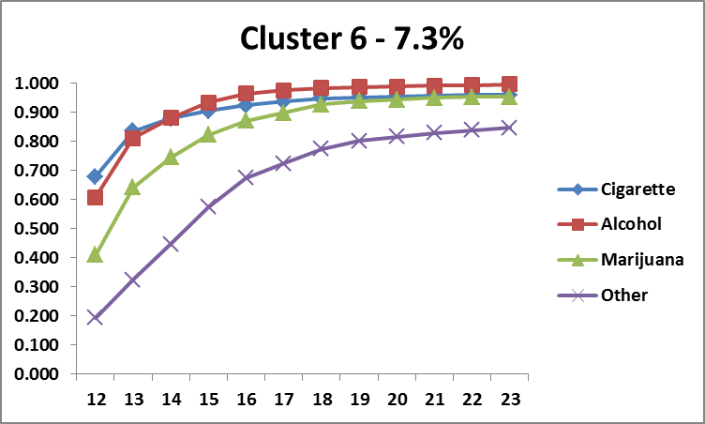
Multiple Process Survival Analysis
Dean (in progress)

Slide 48
Conclusion
…delusion and collusion

Slide 49
Uses of Structural Equation Mixture Models
Direct Applications
  Aim to identify population subgroups that are “real” in some sense
  Unlikely to be fruitful given sensitivity of mixture models to other features of the data and model

Slide 50
Uses of Structural Equation Mixture Models
Indirect Applications
  Use latent classes to gain traction on difficult problems
    Latent variable density estimation
    Semi-parametric estimation of nonlinear/interactive effects
    Approximation of RC-Dependent missing data process in growth analysis
    Approximation of multivariate distribution of event times in multiple process survival analysis
  Many fruitful possibilities given flexibility of SEMM

Slide 51
The Bottom Line
Flexibility of SEMMs poses problems for direct applications but can be exploited in indirect applications
Delusional to hope that indirect applications will appeal to applied researchers as much as direct applications?

Slide 52






Partners in Crime
Ruth Baldasaro aka Ruth Mathiowetz
Patrick Curran
Danielle Dean
Nisha Gottfredson
Jolynn Pek
Sonya Sterba

